Slide 1
SE 577 Software Architecture Intro to Software Architecture

Slide 2
What is Software Architecture?
The fundamental organization of a system, embodied in its components, their relationships to each other and the environment, and the principles governing its design and evolution.
ANSI/IEEE Std 1471-2000, Recommended Practice for Architectural Description of Software-Intensive Systems.

Slide 3
What is Software Architecture? (cont’d)
A software system architecture comprises:
A collection of software and system components, connections, and constraints.
A collection of system stakeholders' need statements.
A rationale which demonstrates that the components, connections, and constraints define a system that, if implemented, would satisfy the collection of system stakeholders' need statements.
Boehm, et al., 1995

Slide 4
What is Software Architecture? (cont’d)
An architecture is the set of significant decisions about the organization of a software system, the selection of the structural elements and their interfaces by which the system is composed, together with their behavior as specified in the collaborations among those elements, the composition of these structural and behavioral elements into progressively larger subsystems, and the architectural style that guides this organization---these elements and their interfaces, their collaborations, and their composition
P. Kruchten: The Rational Unified Process.

Slide 5
What is Software Architecture? (cont’d)
As the size and complexity of software systems increases, the design problem goes beyond the algorithms and data structures of the computation: designing and specifying the overall system structure emerges as a new kind of problem. Structural issues include gross organization and global control structure; protocols for communication, synchronization, and data access; assignment of functionality to design elements; physical distribution; composition of design elements; scaling and performance; and selection among design alternatives. This is the software architecture level of design.
Garlan and Shaw, 1999

Slide 6
Every system has an architecture, regardless if it was planned or not planned
Every system comprises elements and relations among them to support some type of reasoning.
But the architecture may not be known to anyone.
Perhaps all of the people who designed the system are long gone
Perhaps the documentation has vanished (or was never produced)
Perhaps the source code has been lost (or was never delivered)
An architecture can exist independently of its description or specification.
Documentation is critical.

Slide 7
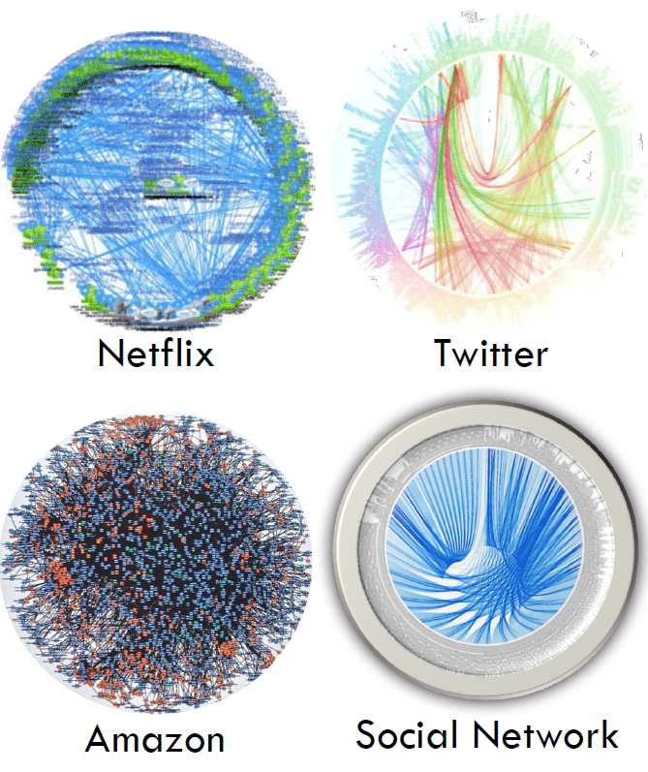

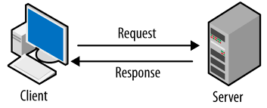
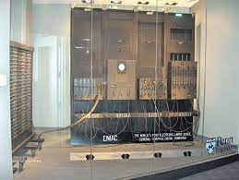
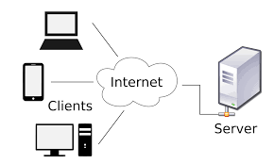
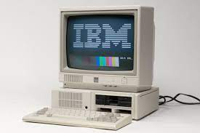
But why do we need architecture?
Massively Scaled Cloud Architectures
Batch Business Processing on Mainframes
Basic Client/Server
monolythic applications on a desktop computer
Basic Web Applications
Purpose Built Computers
1940s
1960s
1980s
1990s
2000s
2010s
2020s

Slide 8
But why do we need architecture?
Massively Scaled Cloud Architectures
Batch Business Processing on Mainframes
Basic Client/Server
Complex, Highly Integrated and Distributed Systems built by very large teams
Able to build things with relatively small isolated teams
Monocytic applications on a desktop computer
Basic Web Applications
PRE-NEED FOR SOFTWARE ARCHITECTURE
NEED FOR SOFTWARE ARCHITECTURE
Purpose Built Computers
1940s
1960s
1980s
1990s
2000s
2010s
2020s
Growth of number of Components in System

Slide 9
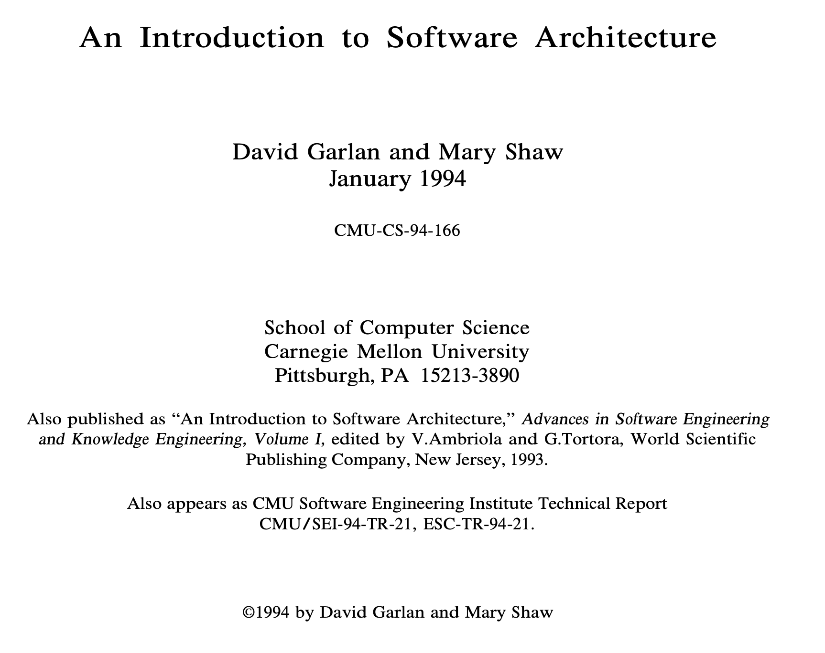
But why do we need architecture?
The Seminal Paper Describing the Need for Software Architecture

Slide 10
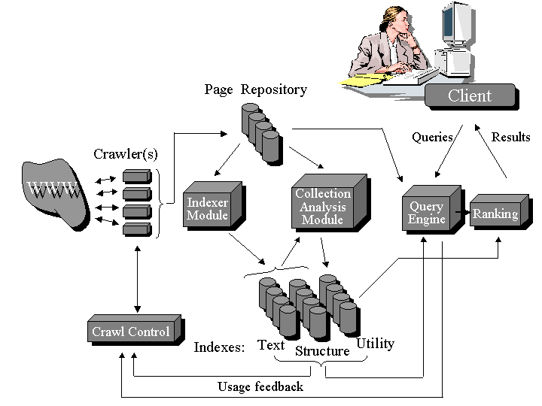
General Search Engine Architecture (Arvind)

Slide 11
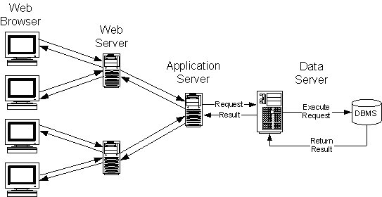
Multi-tier Architecture

Slide 12
Software Architecture as a Design Activity
It’s about software design
All architecture is software design, but not all design is software architecture
Part of the design process
Simply, architecture focuses on issues that will be difficult/impossible to change once the system is built
Quality attributes like security, performance
Non-functional requirements like cost, deployment hardware
More on these later in this course
Generally architecture is about the effective management of constraints on the to be built system

Slide 13
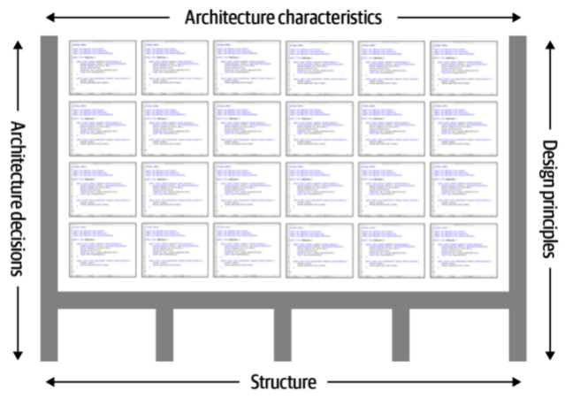
Software Architecture in the Context of Design
The design and code stuff is in here
Architecture is key to constraining and structuring the design of systems
Ref: Fundamentals of Software Architecture – N. Ford & M. Richards

Slide 14
Architecture is Expressed using Models
Software architecture emerged when it was becoming obvious that designs are too complicated to develop from scratch (circa early 1990s)
Good designs tend to be build using models…
1) Abstract different views of the system
2) Build models using precise notations (e.g., UML)
3) Verify that the models satisfy the requirements
4) Gradually add details to transform the models into the design
And such models can be derived from proven/established architecture patterns – more on this later

Slide 15
Architecture Abstractions
There are different techniques to perform software architecture analysis…
Reference Architecture – focus is on the broad domain
Solution Architecture – focus on the solution space
Software Architecture – focus on the key technical abstractions
As well as a diversity of use cases where this information can be useful…
New product definition
Monitoring design quality (trends)
Redocumenting and/or extending the lifespan of existing systems
The “art” of architecture is to pick the correct abstractions based on the desired objectives or outcomes

Slide 16
Architecture Framing
When thinking about a reference-, solution-, or software architecture focus on:
Who is the constituent – aka, who am I trying to talk to or influence
What do I want them to understand – aka, why am I talking about architecture
What are the benefits, constraints, or tradeoffs associated with the architecture I am describing
If you cant answer any/all of the above questions the impact of your architectural work will likely be sub-optimal
We will look at documentation approaches later, but I’m not necessarily a big fan of standard notations – more on that later.

Slide 17

Architecture Done Poorly …

Slide 18
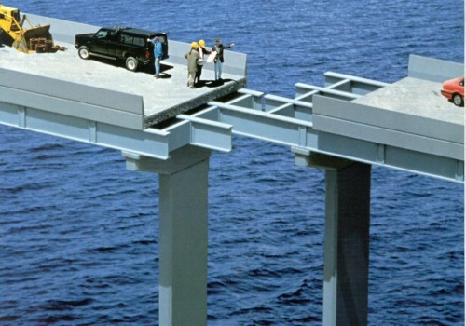
Get it Right the First Time !

Slide 19
Why Study Architecture?
It is an integral aspect of structuring software so that it can be built, understood and maintained:
Client / Server
Layered systems
Cloud based systems
etc
Architectural choices are critical in determining SW quality:
Performance
Scalability
Reuse
… and other non-functional properties

Slide 20
Why Study Architecture? (cont’d)
As a architect, you need to:
Effectively manage complex tradeoffs to meet stakeholder objectives
Layout, socialize and influence your decisions.
Communicate with your team and convince your customer / boss of their merit.
Reason about the properties of the overall system in an abstract and convenient way.

Slide 21
Why Study Architecture? (cont’d)
Certain “canonical” architectural designs provide valid blueprints for a lot of systems.
Architectural styles
Learn to recognize applicability and characteristics of styles.
Learn to use technologies that induce and support those styles.

Slide 22
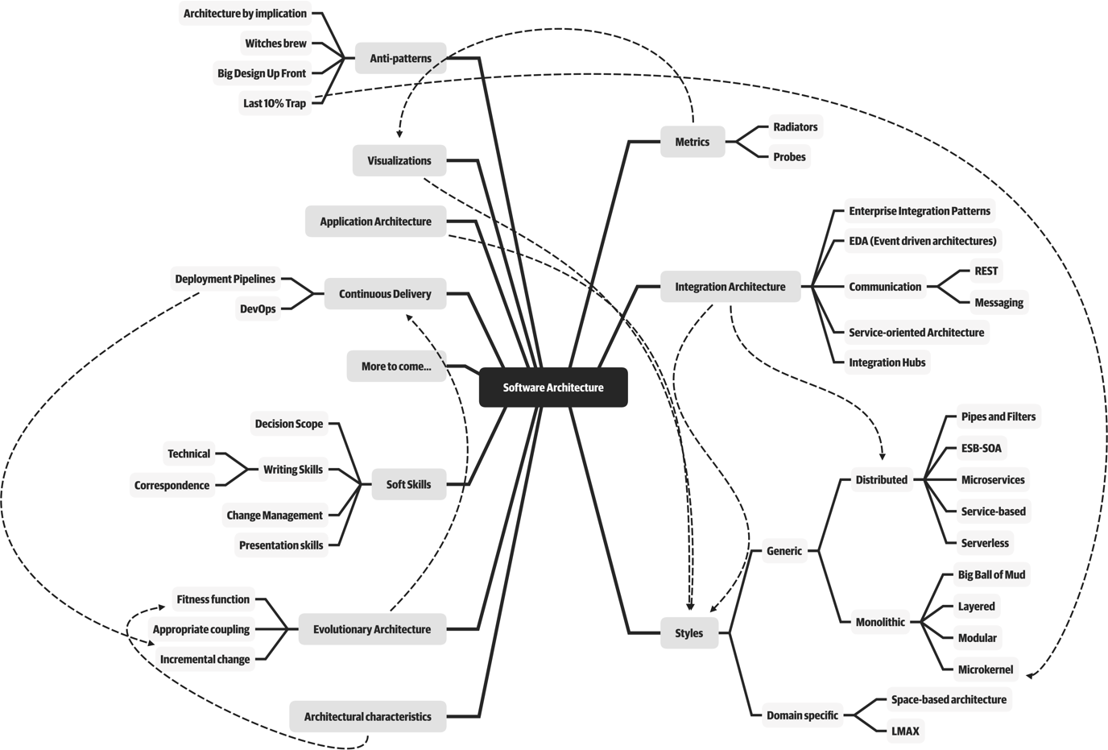
Software Architects need to cover a lot of ground

Slide 23
What does a Software Architect do?
Interact with stakeholders to make sure their needs are being met.
Craft the right architecture to solve the problem at hand.
Make sure the right modeling is being done, to know that qualities like performance are going to be met.
Make sure that the architecture is not only the right one for operations, but also for deployment and sustainment.
Document, influence, and communicate it.
Give input as needed to issues like tool and environment selection.
Manage risk identification and risk mitigation strategies associated with the architecture, and architecture decisions.
Work closely with engineering teams, ensuring architecture guidance is relevant, is followed, and is adding value.

Slide 24
Expectations of a software architect
Be able to create abstractions and models that capture key constraints and tradeoff decisions
Continually analyze and update architecture as new things are learned
Keep current with the latest trends
Ensure compliance with decisions
Have diverse exposure and experience
Have business domain knowledge
Possess interpersonal skills (required for influencing)
Understand and navigate politics
Effectively demonstrate credibility to diverse audiences

